Slide 1

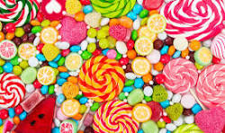

Module 3.2
How can a computer learn to classify objects from examples?
Living and Working with Artificial Intelligence
Developed for the AI4GA (Artificial Intelligence for Georgia) project funded by National Science Foundation awards DRL-2049029 and DRL-2048502.
Additional funding was provided by a gift from Google. This work is licensed under the Creative Commons Attribution-NonCommercial-ShareAlike 4.0 International License. https://creativecommons.org/licenses/by-nc-sa/4.0/

Slide 2
Try It #1: Candy Land - Creating a Candy Classifier
Setup: (a) Get a handout for drawing your tree; (b) cut out pictures of candy that you can move around the nodes of your tree.
Step 1: Propose a bunch of features to distinguish between the candy types,
Step 2: Pick a feature that will split the candy into two roughly equal groups.
Doing this every time will give you the smallest number of nodes.
This is similar to how real machine learning algorithms decide which feature to use for the next node.
Step 3: Take the features, build the decision tree.
Make sure every one of your types of candy is a leaf.
You may not have enough features - if you end up with two types of candy on the same leaf.
Step 4: Test this out and update the features and the tree.
Step 5: Convert the tree into a table.
The columns are the features (red - replace question).
The rows are the leaves.
If the feature doesn’t apply, put N/A.

Slide 3
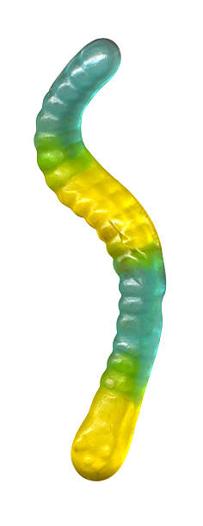
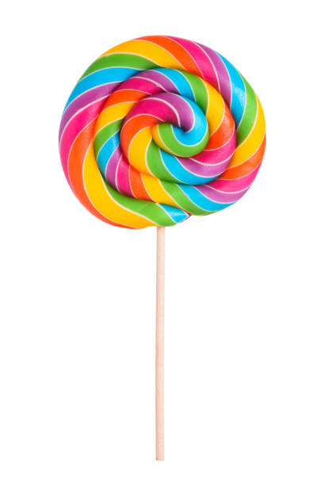
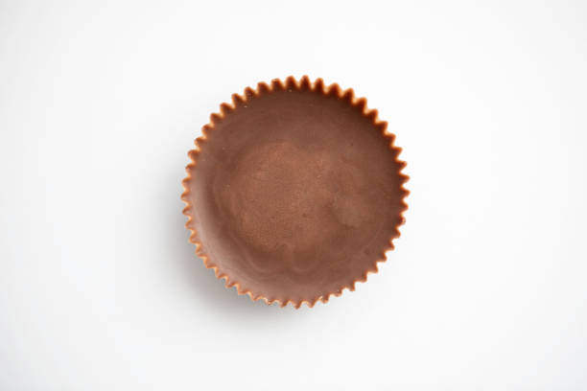
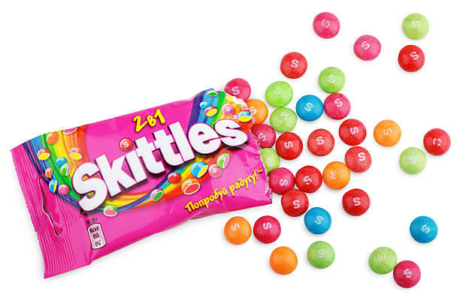
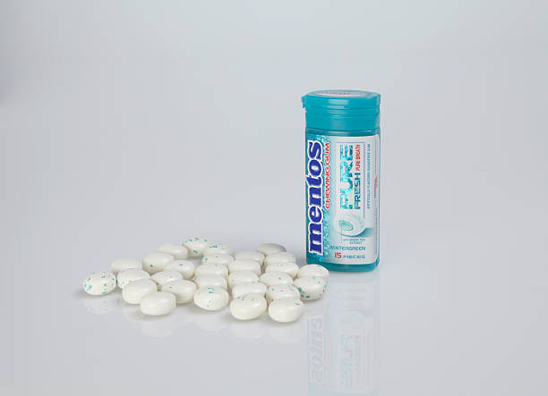
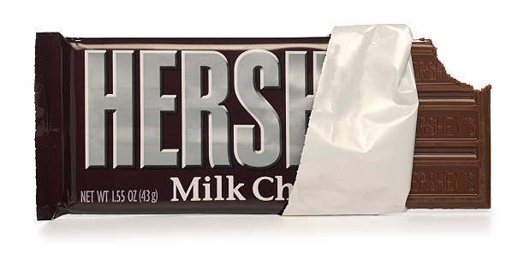
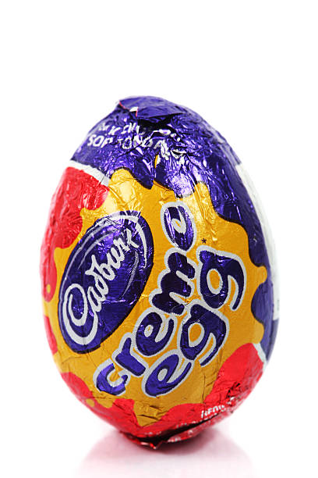
Candy Data Set
Gummy Worm
lollipop
Reese
skittles
Hershey Bar
Mentos
Cadbury Egg
Notes:
https://www.delish.com/uk/food-news/g31017969/pasta-shapes/
https://en.wikipedia.org/wiki/List_of_pasta

Slide 4
A feature is a property of a thing we are trying to describe.
Write features for the candies in our dataset.
Features
Features
Features
Features
Features
Features
Features

Slide 5
Pick a feature from your last slide that roughly half of your candy shares. Turn that feature into question that can be answered with yes or no and write it in the red box. This is the root node, the beginning of your decision tree.

Slide 6
Yes
No
FIll in your tree from the last slide. Then drag your candies to the end of the link that it belongs in.
Add two new feature questions to split your two groups of candies in half again.

Slide 7
Yes
No
Yes
No
Yes
No
FIll in your tree from the last slide. Then drag your candies to the end of the link that it belongs in.
Add four new feature questions to split your four groups of candies in half again. If a link only has one candy, do not add a feature question. Just leave it at the end of the link.

Slide 8
Yes
No
Yes
No
Yes
No
Yes
No
Yes
No
Yes
No
Yes
No
FIll in your tree from the last slide. Then drag your candies to the end of the link that it belongs in.

Slide 9
Now that we’ve created our classifier
We can describe candy using feature vectors.
A feature is a property of a thing we are trying to describe.
A featurE Vector is an ordered list of properties.
Our feature vector:
Candy Air Head | Is is round? N
Notes:
This is the same idea of the semantic space of the word embedding vectors
Except in the word embedding vector - the computer figures out the features
These features dont’ have to be binary, it might have a numerical value
Is the length > of pasta

Slide 10
Feature Vector Description of Candy Respond Yes or No
Feature Feature Feature Feature Feature Feature Feature
Candy
Notes:
This is the same idea of the semantic space of the word embedding vectors
Except in the word embedding vector - the computer figures out the features
These features dont’ have to be binary, it might have a numerical value
Is the length > of pasta

Slide 11
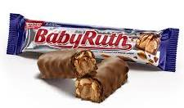
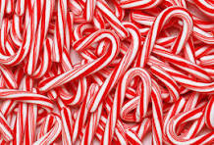
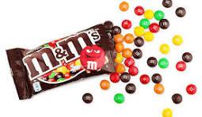

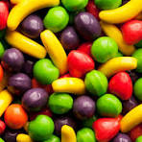
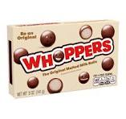
Use this test set to see how effective your features are at classifying a new set of candies
Pick 3 candies
M & Ms
Baby Ruth
Candy Canes
Sour Punch Straws
Whoppers
runts

Slide 12
Test Set - Data Collection Sheet
Candy | Correctly classified | Incorrectly classified

Slide 13
Feature Vector Description of Candy
Add more columns to fit all your features & more rows to fit all your candies
Candy | Is it multicolor | Is it round | Is it a quadrilateral
M&M
Candy canes
Candy corn
Runts
Sour punch straws
Baby ruths
Whoppers
Notes:
This is the same idea of the semantic space of the word embedding vectors
Except in the word embedding vector - the computer figures out the features
These features dont’ have to be binary, it might have a numerical value
Is the length > of pasta

Slide 14
Feature Vector Description of Candy
Add more columns to fit all your features & more rows to fit all your candies
Candy
Notes:
This is the same idea of the semantic space of the word embedding vectors
Except in the word embedding vector - the computer figures out the features
These features dont’ have to be binary, it might have a numerical value
Is the length > of pasta

Slide 15
Reflection
How well did your candy classifier do on this new test set? What candies did it classify incorrectly?
Were your features flexible enough to allow you to classify new candy? Why or why not?
How would you change your features to allow them to better classify a wider range of candies?

Slide 16
Takeaways

Slide 17
If your data is in a feature vector table like this then you don’t have to build the tree yourself
People don’t usually build decision trees by hand because for realistic tasks it can be hard.
For practical problems, people build a table that may have thousands of rows (examples) and dozens of columns (features). Each example is labeled with the correct decision (i.e., the class it belongs to).
Then they use a machine learning algorithm to create the decision tree.
Machine Learning is a process for constructing a reasoner (such as a decision tree classifier) using training data and a learning algorithm.

Slide 18
Let’s look at some examples from the real-world

Slide 19
Try It #2: Think of a real-world example
Step 1: Pick a situation in the real world where computers might make decisions
Step 2: Think about the attributes that would contribute to making good decisions
Step 3: Reflection: Think about how your life is being affected by classifier systems (automated decision making).
Examples
Classifying toys based on age.
What kinds of features make a toy suitable?
Classify games, movies, and music
Reviewing loan applications.
What kinds of things help us determine the strength of a loan application?
College applications.
What kinds of things make for a strong college application?

Slide 20
Computers don’t learn the way people do.

Slide 21
How do people learn?
Discussion
Notes:
Answer - It solves a problem by asking a series of questions.

Slide 22
Ways people learn
Being taught by someone (e.g., parent, teacher, sibling, friend)
Asking questions
Observing others
Reading
Trial and error
Systematic experimentation
Everyday life experiences
Note: None of these are things that computers currently do well.

Slide 23
Ways Computers Learn
Learning from labeled examples (like Pasta Land and Teachable Machine)
  This is called supervised learning
  We will only explore supervised learning in this unit
Finding clusters in data
  This is called unsupervised learning because the data does not come pre-labeled
  Example: examining data on plants collected from a forest and decided how many different species of plants there are in the forest
Learning from experience via trial and error
  This is called reinforcement learning
  This is how computers learn good strategies for playing games
Learning by being told
  This is called zero shot learning.
  Large language models like ChatGPT can learn a new task by being told what to do and they will follow those instructions.
Notes:
Note - Learning by being told has been added in April 27,2023 to accommodate the appearance of ChatGPT

